Slide 1


Microsoft® Lync™ 2010
Web App Training

Slide 2
Objectives
This course introduces the Microsoft Lync Web App and covers the following topics:
Lync Web App Overview
Join Online Meeting Experience
Invite Additional Participants
Start Application Sharing
Obtain Client Side Logs
Appendix
Notes:
Microsoft Lync Web App is a Silverlight based browser application that allows authenticated as well as external users to participate and collaborate in online meetings using a browser.

Slide 3
Overview
Lync Web App provides a browser based alternative for joining a Lync Online Meeting. Lync Web App requires a Microsoft Silverlight enabled browser.
It offers a similar Online Meeting experience as the Lync 2010 client. However, participants do not have to install additional software to attend and participate in an Online Meeting. If you intend to present and perform desktop sharing you must install an additional sharing plug-in.
Silverlight
Anyone using a Silverlight supported browser and Operating System with an Internet connection can join a Lync Online Meeting without installing the Lync client or Lync Attendee client.
Silverlight is a cross-browser and cross-platform browser plug-in that helps deliver applications and experiences on the Web.
During the Web App Join experience the participants browser automatically searches for the Silverlight installation and prompts the user to install it if necessary. Silverlight can also be installed from here: http://www.microsoft.com/getsilverlight

Slide 4

Join Online Meeting Experience
The following section introduces you to the Join Online Meeting experience for Lync Web App. The following slides display a visual workflow and demonstration of this experience.
The participant may receive onscreen prompts to install Silverlight or allow a pop-up, and their computer does the rest.
BACK TO OBJECTIVES

Slide 5
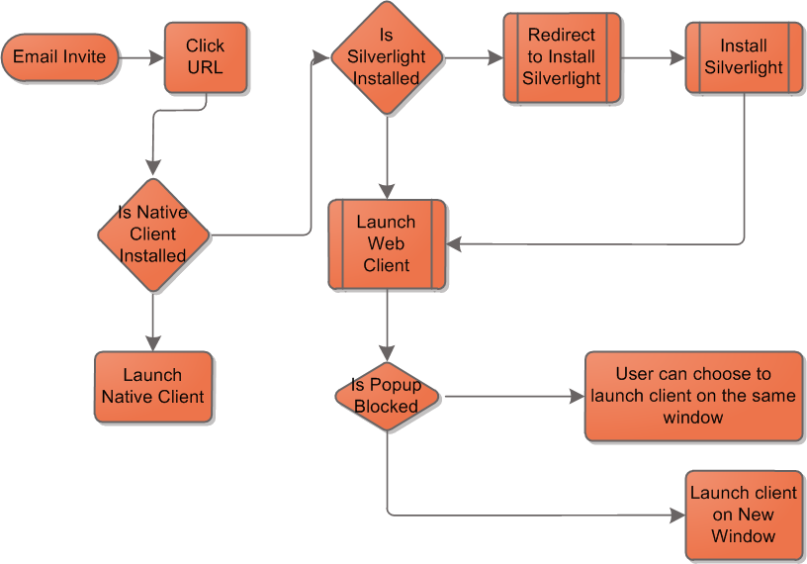
Join Online Meeting Experience Flowchart
Joining an Online Meeting using Lync Web App requires minimal clicks to get participants connected quickly.
No
Yes
No
Yes
Yes
No

Slide 6
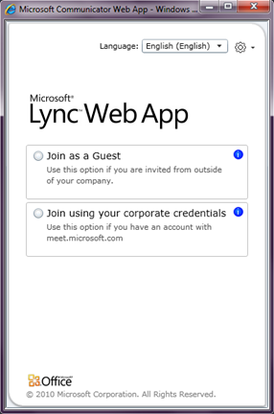
Lync Web App Join Experience
These instructions explain how to join and connect to the audio portion of an Online Meeting.
Note: Silverlight is required.
Join Experience
Open Online Meeting invitation.
Click Join online meeting hyperlink or manually copy/paste the meeting URL into a browser.
Join as a guest or use corporate credentials.
  Click Join as a Guest if you are attending the meeting from outside the company.
  Click Join using your corporate credentials if you have them.
Complete onscreen information such as your display name and click Join Meeting.
Click the Phone button on the mode bar.
Enter your office or cell phone number on Phone Details and click Call Me.

Slide 7
Performing Common Tasks
The following section introduces you to primary actions a participant will complete during an Online Meeting.
BACK TO OBJECTIVES

Slide 8
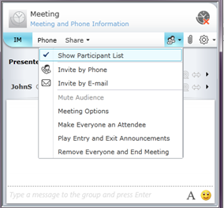
How to Invite Additional Participants
Additional Participants can be invited by the Presenter through the People menu.
Invite Participant to Audio Conference
Click drop down menu for People.
Click Invite by Phone, and type participants phone number. The Online Meeting will automatically dial that number and connect participant to audio conference.
Invite Participant to Online Meeting
Click Invite by E-mail
Click the Copy All Text button.
Open Outlook and click New E-mail.
Complete To recipient information and Subject.
Press Ctrl +V to paste text into body.
Click Send
BACK TO OBJECTIVES

Slide 9
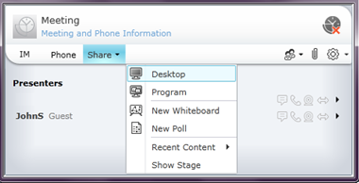
How to Start Application Sharing
Application Sharing is the primary method of displaying content in an Online Meeting.
Presenters can share their entire desktop or a single application such as a PowerPoint presentation.
Note: First time users must install the Application Sharing Plug-in for Lync Web App.
How to Start Application Sharing
Click Share.
Click Share your Desktop or Program.
Click Allow on warning dialog if you are prompted.
Click Start Sharing.
Note: Participants will see all content surrounded by the green bars.
Click Give Control to share control with another participant.
Click Stop Sharing at the top of screen to end sharing.
BACK TO OBJECTIVES

Slide 10

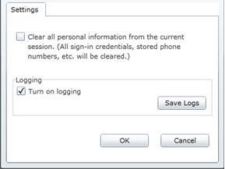
How to Obtain Client Side Logs
For advanced troubleshooting or escalation procedures client side logs can be obtained from the Lync Web App.
Note: Client side logs are captured in .log format and can be read with any text editor such as Notepad.exe.
How to Obtain Client Side Logs
Click Options menu.
Click Options.
Confirm Turn on Logging is enabled. (enabled by default)
Click Save Logs.
Type a file name for logs and click Save.
File name can be anything that helps you remember what it is. As a recommendation title the file using customer Service Request (SR) number. Examples:
SR0000999.log
Lync Web App Log mm-dd-yy.log
Click Options menu to access the client side log or clear personal information options.
BACK TO OBJECTIVES

Slide 11
Review
This course introduced the Microsoft Lync Web App and covered the following topics:
Lync Web App Overview
Join Online Meeting Experience
Invite Additional Participants
Start Application Sharing
Obtain Client Side Logs
Appendix
Notes:
Microsoft Lync Web App is a Silverlight based browser application that allows authenticated as well as external users to participate and collaborate in online meetings using a browser.

Slide 12
Appendix
BACK TO OBJECTIVES

Slide 13
Lync Web App Terms
Term | Definition
Meeting Attendees | Attendees can only view content. Attendees are not allowed to share content/files/desktop/whiteboard. Attendees can invite other contacts to a meeting.
Meeting Presenters | Includes all Attendee privileges. Presenters can share desktop/ apps, Presenters can upload content and save content locally. Presenters can create Whiteboards. Presenters can admit people from lobby Presenter can eject other participants except the Organizer. Presenter can promote Attendees. Presenter can demote other presenters except Organizer. Presenters can mute other participants. Presenters may have the ability to browse content. Presenters can Lock a meeting.
Meeting Organizer | Have all the privileges of Presenters. Organizer cannot be ejected from a conference. Organizer cannot be demoted. Organizer can never be made to wait in the Lobby. There is no special icon or text indicating an organizer role in roster. The role of organizer is not “transferrable” Meaning, there is no concept of “promote to organizer”.
Meeting Participants | Collective term for Presenter, Organizers and Attendees.
BACK TO OBJECTIVES

Slide 14
Lync Web App Terms (cont.)
Term | Definition
Roster | Control that enlists Meeting participants
Presenter Lobby | Control that enlists meeting invitees awaiting admission by the Presenter
Meeting Access | Control that allows Presenters to alter Meeting admission policies.
Meeting Policy | Admin defined policies for the meeting.
Meeting Permissions | Control that allows Presenters to alter preset functionalities of Meeting participants during a meeting.
Public Meetings | Meetings where the trust level between meeting participants is high. These meetings have the following characteristics All authenticated users are automatically presenters. All federated/ non-federated/ anonymous users are attendees
Private Meetings | Meetings where the access to meeting needs to be controlled. In such meetings Organizers specifically pre-assign presenters and attendee roles.
BACK TO OBJECTIVES

Slide 15


© 2010 Microsoft Corporation. All rights reserved. Microsoft, Exchange ActiveSync, Excel, Lync, Outlook, PowerPoint, SharePoint, SQL Server, Windows, Windows Live, Windows Mobile, Windows Server, and other product names are or may be registered trademarks and/or trademarks in the United States and/or other countries/regions. The information herein is for informational purposes only and represents the current view of Microsoft Corporation as of the date of this presentation. Because Microsoft must respond to changing market conditions, it should not be interpreted to be a commitment on the part of Microsoft, and Microsoft cannot guarantee the accuracy of any information provided after the date of this presentation. MICROSOFT MAKES NO WARRANTIES, EXPRESS, IMPLIED OR STATUTORY, AS TO THE INFORMATION IN THIS PRESENTATION.
BACK TO OBJECTIVES

